Slide 1
Digital Image Processing in Python
Alon Oyler-Yaniv – alonyan@g.ucla.com
https://github.com/alonyan/DIP

Slide 2
Workshop overview
Day 1
Core concepts and motivation.
What is a digital image.
Pixel-level operations.
Day 2
Pixel-level operations (cont.)
Variance balancing (thresholding)
Image segmentation
Day 3
Image segmentation (cont.)
Feature extraction
Intro to modern computer vision

Slide 3
Workshop goals
The workshop is an introduction to digital image processing, designed to give you a taste of what's possible with a specific emphasis on microscopy data.
By the end of the workshop, you should:
Acquire basic understanding and familiarity with computer vision.
Appreciate the importance of rigorous and systematic image analysis for reproducible and quantitative science.

Slide 4
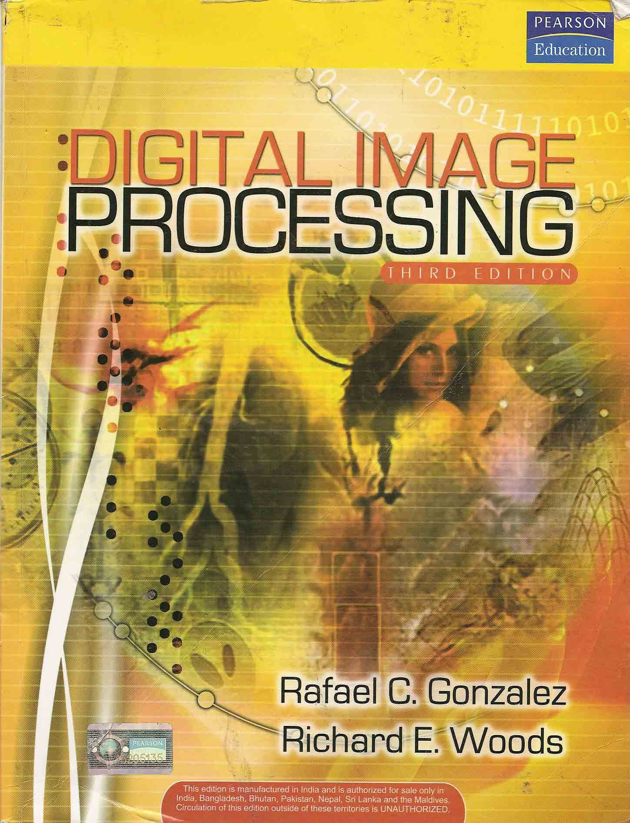
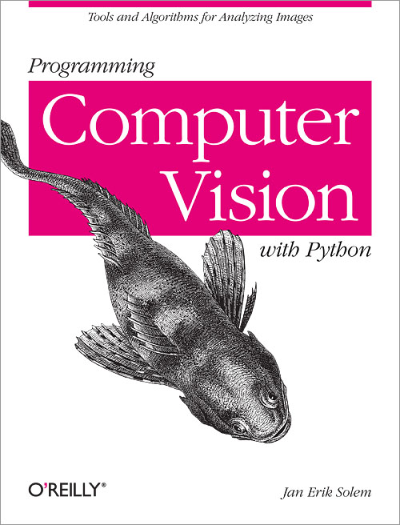
Other resources
MOOC: https://www.mooc-list.com/course/image-analysis-methods-biologists-futurelearn
https://www.youtube.com/watch?v=1xo4vi6Ub4I
http://web.ipac.caltech.edu/staff/fmasci/home/astro_refs/Digital_Image_Processing_2ndEd.pdf
http://programmingcomputervision.com/

Slide 5
What is an Image?
Photons are focused by lens (and cornea) and form an image on the retina.
Activate a 2D array of photoreceptor cells that are sensitive to different colors.
Information is passed to brain via optic nerves.

Slide 6
What is an Image?
Photons are focused by a lens and form an image on an image sensor.
Activate (charge) a 2D array of pixels on an image sensor (CCD/CMOS/PMT).
(Sometimes there are color filters)
Computers store information in bits , so the information must be digitized (ADC).
Information is stored as a matrix of numbers.

Slide 7
How is pixel data stored in the computer?
Data type | Range
uint8 – unsigned 8 bit integer | 0 to 255
uint16 – unsigned 16 bit integer | 0 to 65535
uint32– unsigned 32 bit integer | 0 to 2³² - 1
float – floating point, single (32 bit) or double (64 bit) precision | -1 to 1 or 0 to 1
int8 - signed 8 bit integer | -128 to 127
int16 - signed 16 bit integer | -32768 to 32767
int32 - signed 32 bit integer | -2³¹ to 2³¹ - 1
The cost of higher precision is higher memory use.
Higher precision is sometimes pointless, depending on the data and what you need to get from it.

Slide 8
What is an Image?
Photons are focused by lens and form an image on an image sensor.
Activate (charge) a 2D array of pixels on an image sensor (CCD/CMOS).
(Sometimes there are color filters)
Computers store information in bits , so the information must be digitized (ADC).
Information is stored as a matrix of numbers.

Slide 9
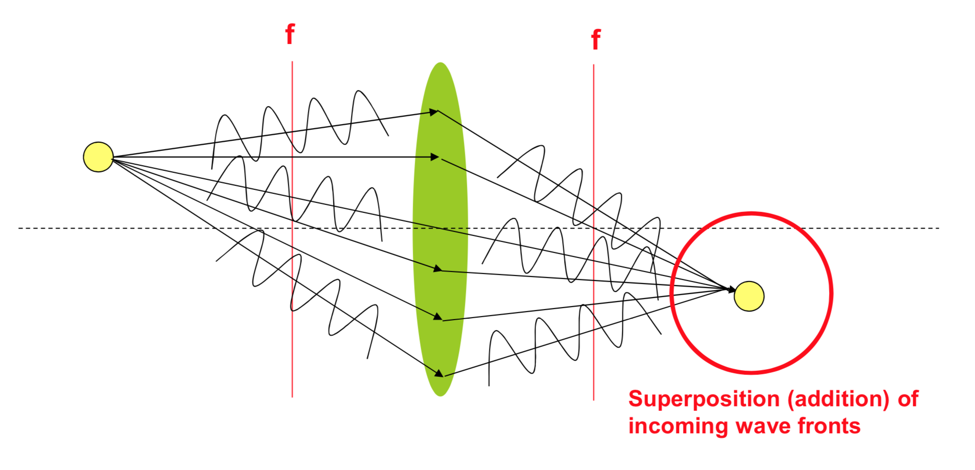
Image Resolution
Light propagates as a wave.
Waves can have constructive or destructive interference.
Lenses are designed to maximize constructive interference at the focal plane.

Slide 10
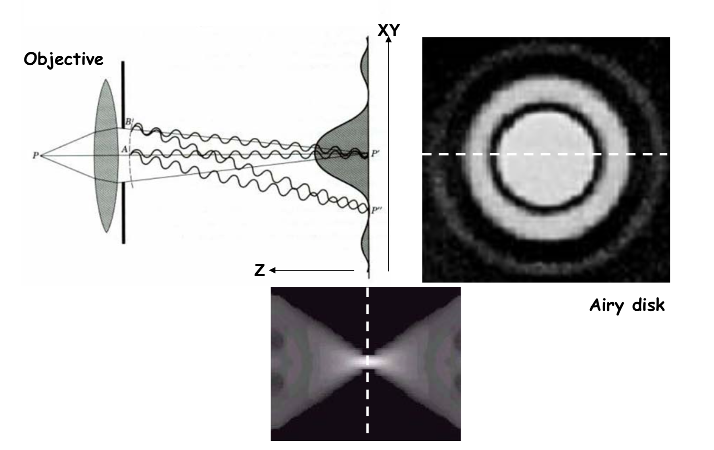
Image Resolution – Point Spread Function
Image of point source - PSF

Slide 11
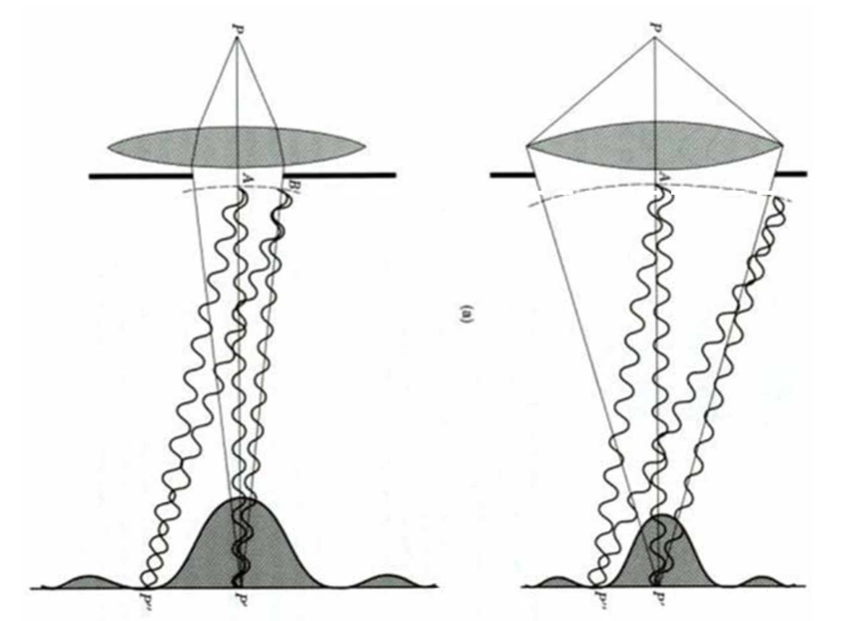
Image Resolution – Effect of Numerical Aperture
NA =
Larger NA = Thinner PSF
Magnification
NA

Slide 12
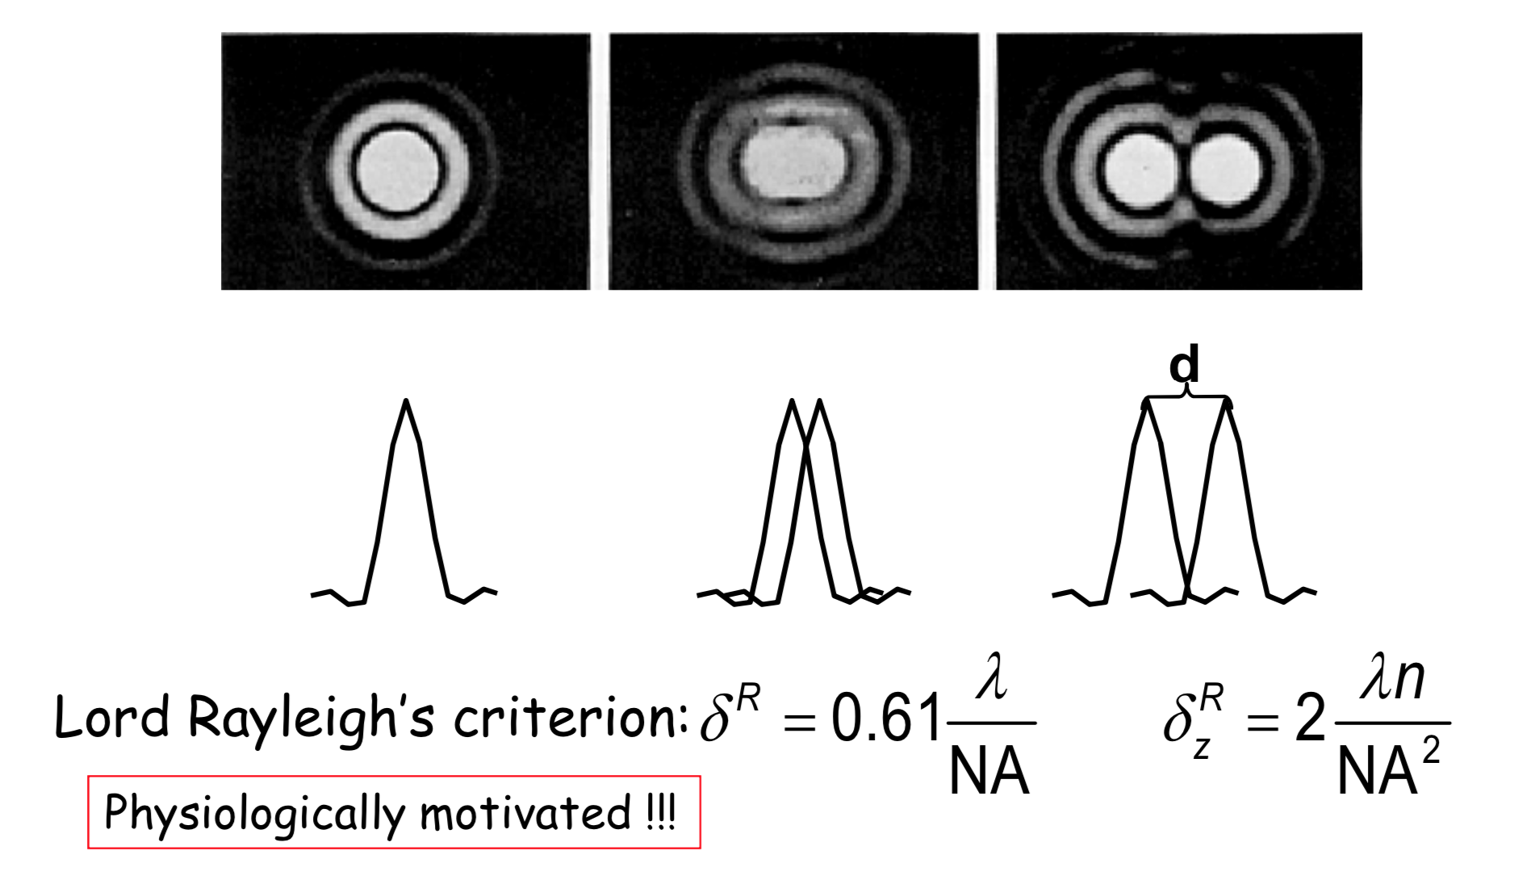
Image Resolution – How close two point can be and still be separable
Aka Abbe diffraction limit

Slide 13
Image Resolution and magnification
Notice that the objective magnification does not affect Abbe’s diffraction resolution formulae:
Caveat: is the area captured by each pixel
in the camera.
If that is larger than Abbes limit than the
resolution is set by that. In that case the system
is not diffraction limited.
Magnification
NA

Slide 14
What is Image Processing?
Bunch of monkeys with different attributes
Our brain is really really good at this!
Computer vision - teach computers to interpret and understand the visual world

Slide 15
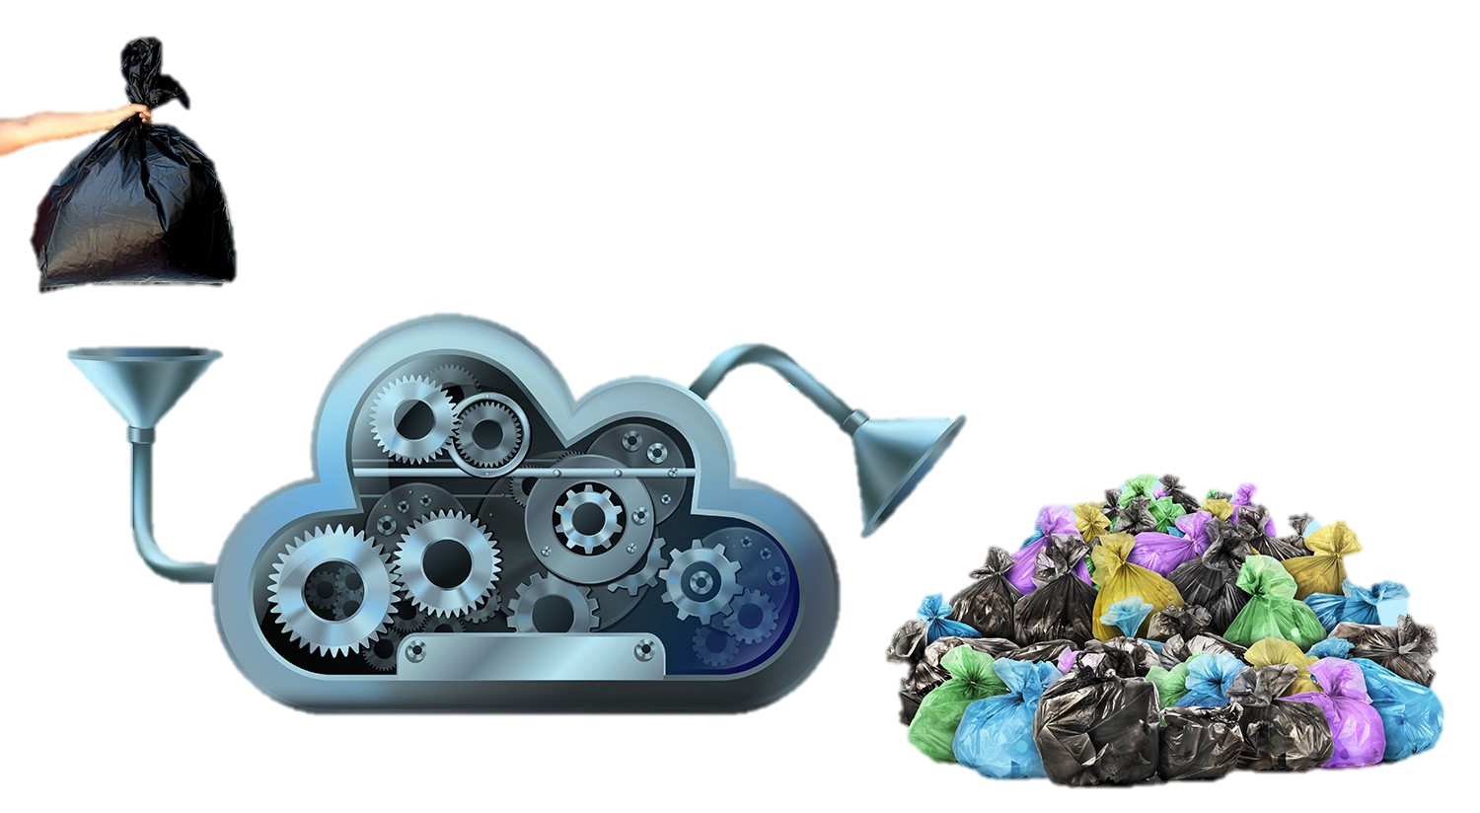
What is not Image Processing?
Image processing is not magic
Image processing doesn’t create new data – that’s called image manipulation/forgery
It’s always better to fix problems on the acquisition side than on the processing side
Good data is key!

Slide 16
Why do we need image processing?
If we’re so good at this, why do we need computers?

Slide 17
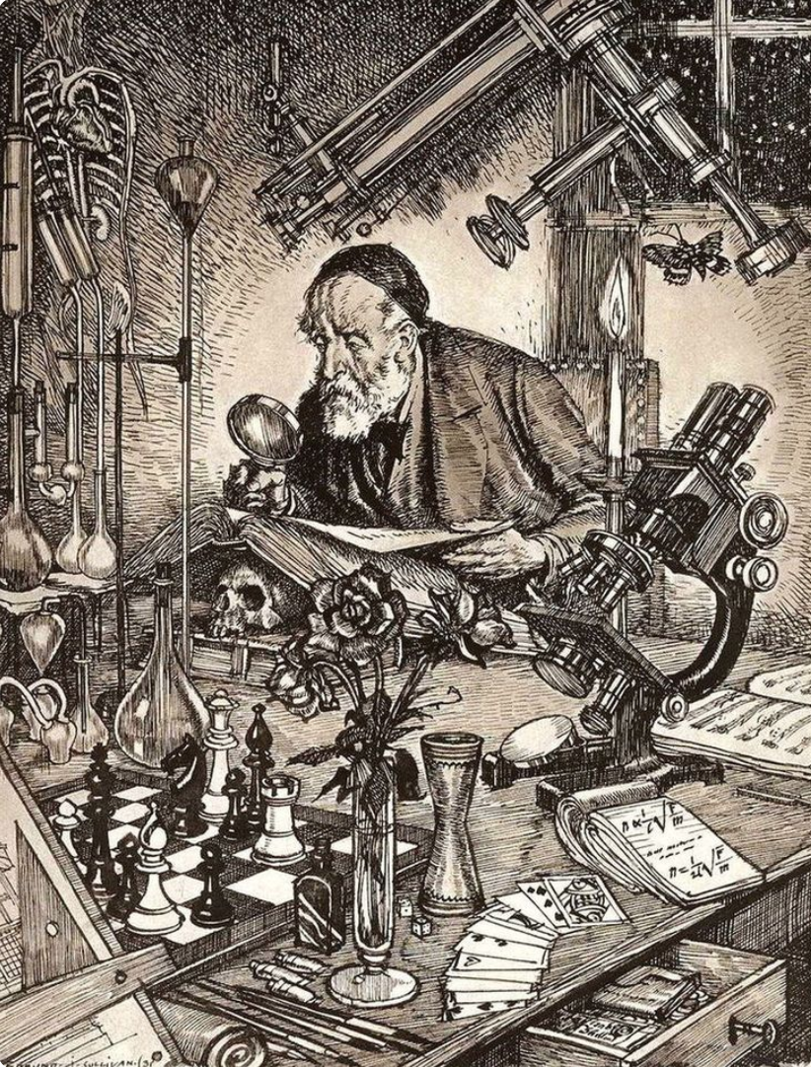
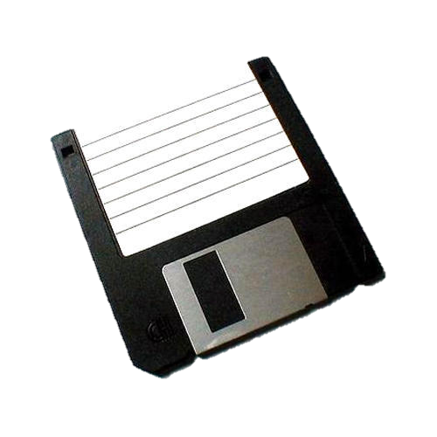
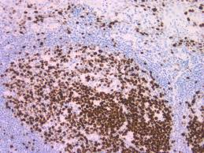
(Optical) Microscopy circa y<2000 (b.f.p)
Primarily antibody based
Mostly fixed samples
Low (throughput) and slow
MB scale data,
typically ~10 images
Image analysis was often performed manually,
usually on a subset of the data (“cherry picking”)
And heuristic methods that “make sense”

Slide 18
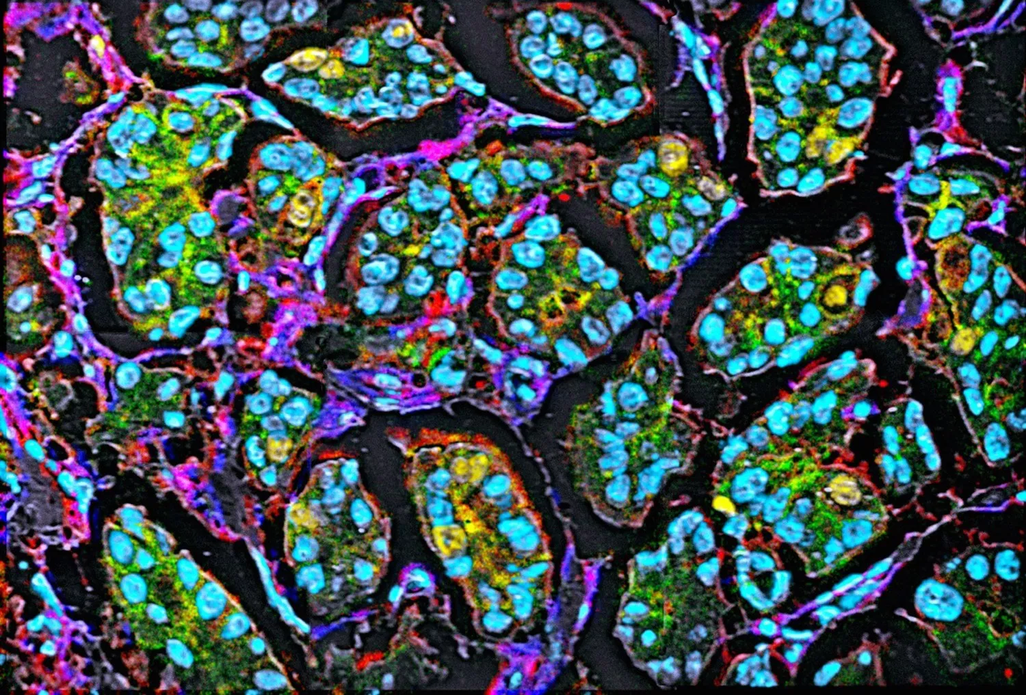
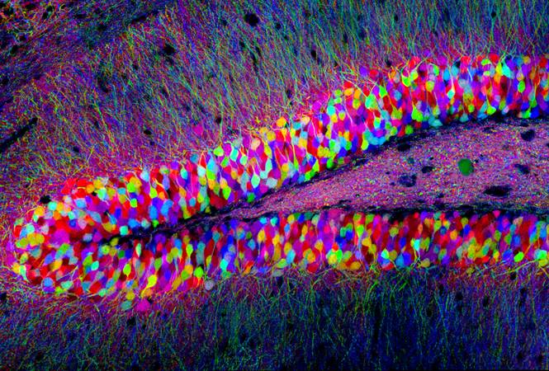
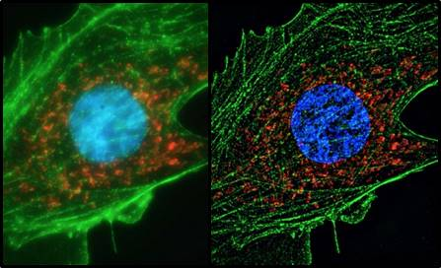
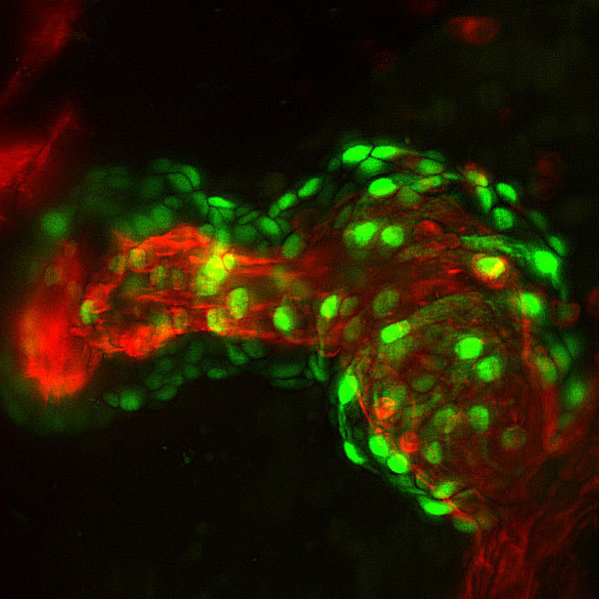
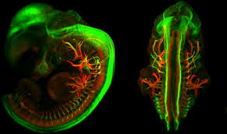
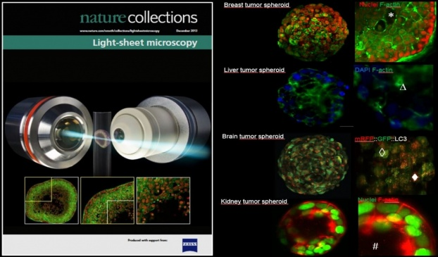
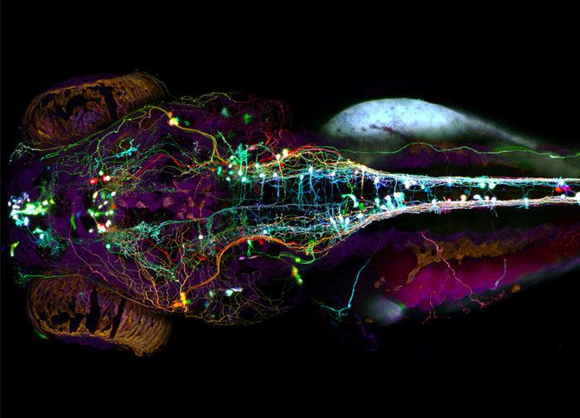
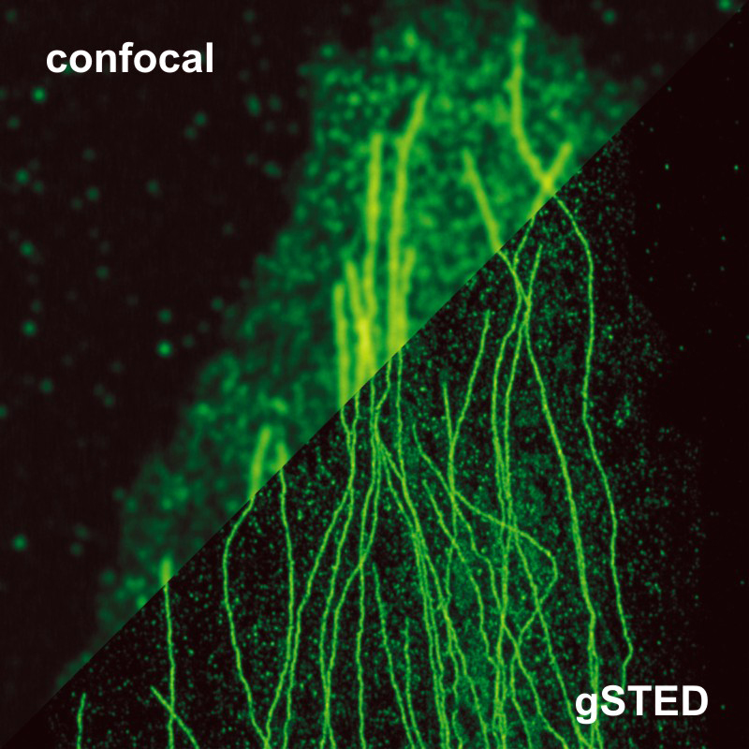
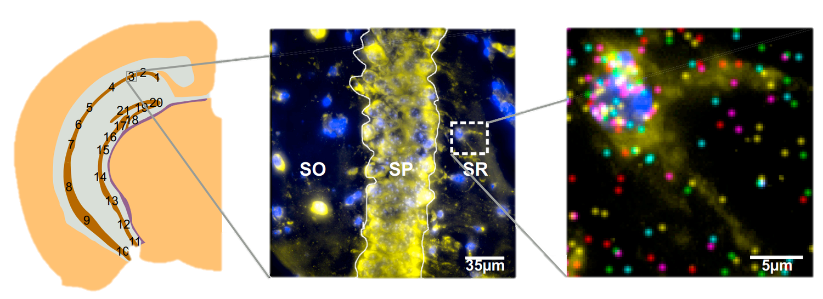
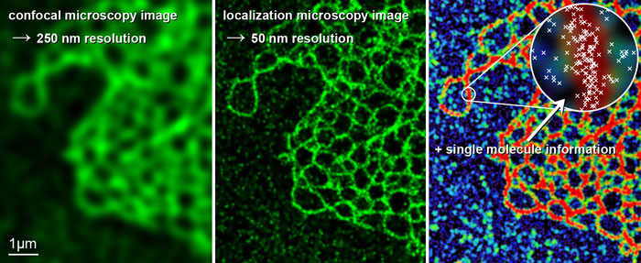
Microscopy circa y>2000 (a.f.p)
FPs allow multichannel, live, long time imaging.
New technologies:
Imaging beyond Abbe limit (STORM,PALM,STED,SIM…).
Imaging of whole organisms in 5D using LSFM (SPIM, Scanning beam, OPM,…) .
Multiplexed in situ RNA FISH (MERFISH, SeqFISH).
Multiplexed IF (CyCIF, MIBI)
Cryo-EM
The scale and type of data for the modern microscopist has exploded in the last 2 decades.
GB-TB scale data. In some cases ~10⁶ Images/experiment. Manual image analysis becomes impractical.
Imaging has become a big data + high throughput problem.
Notes:
Most labs today sit somewhere in between, and still there are reasons to want more systematic analysis

Slide 19
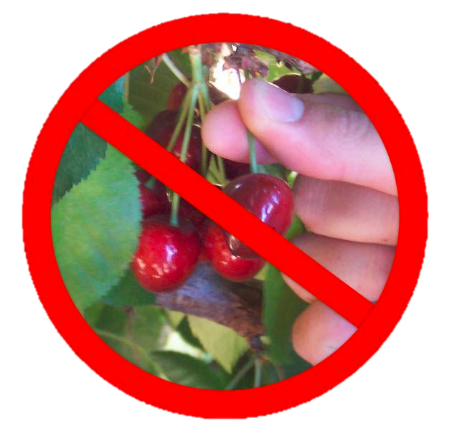
Reproducibility
Our goal is to extract meaningful, quantifiable information in a non-biased manner from imaging data.
Manual, non-systematic, image analysis is prone to bias.

Slide 20
Computational Image processing
Image processing is about extracting the relevant data from your measurements, but not about analyzing them.
Monkey ID | M/F | size | Coat Color | Attr 1 | Attr 2 | Attr 3 | …
1 | F | 24 | …
2 | F | 40
3 | M | 87
4 | M | 21
5 | F | 31
6 | F | 24
7 | F | 54
Something something computers…

Slide 21
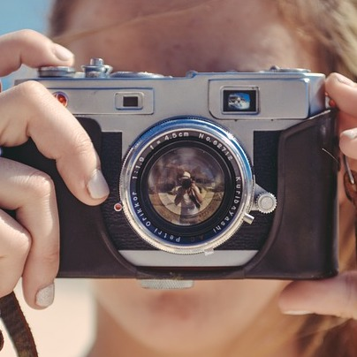
What might an image processing pipeline look like?
Image acquisition

Slide 22
What might an image processing pipeline look like?
Image acquisition
Image Preprocessing
Aligning
Tiling
Denoising

Slide 23
What might an image processing pipeline look like?
Image acquisition
Image Preprocessing
Aligning
Tiling
Denoising
Image Processing
Background / Foreground
Segmentation
Feature extraction
Conversion to data

Slide 24
What might an image processing pipeline look like?
Image acquisition
Image Preprocessing
Aligning
Tiling
Denoising
Image Processing
Background / Foreground
Segmentation
Feature extraction
Conversion to data
Data Analysis
Anything that can be learned from the data

Slide 25
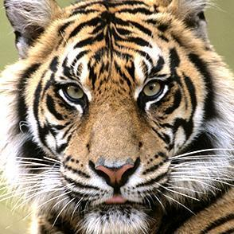
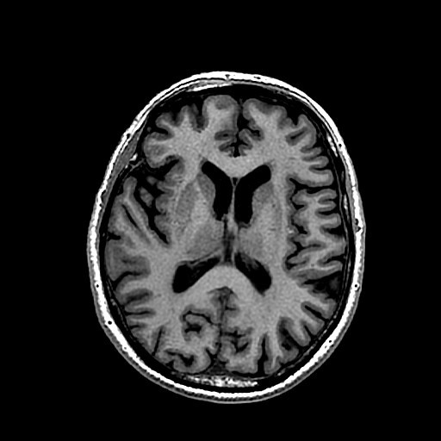
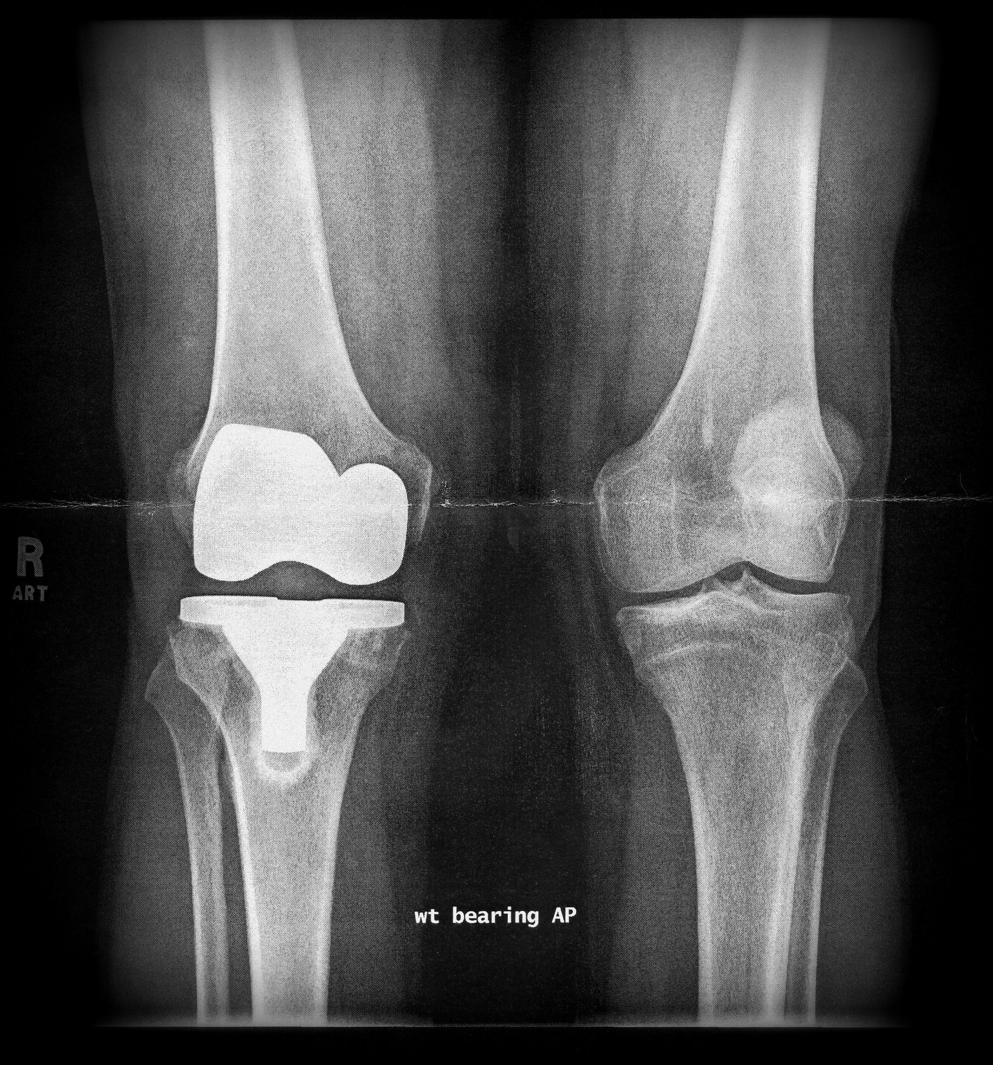
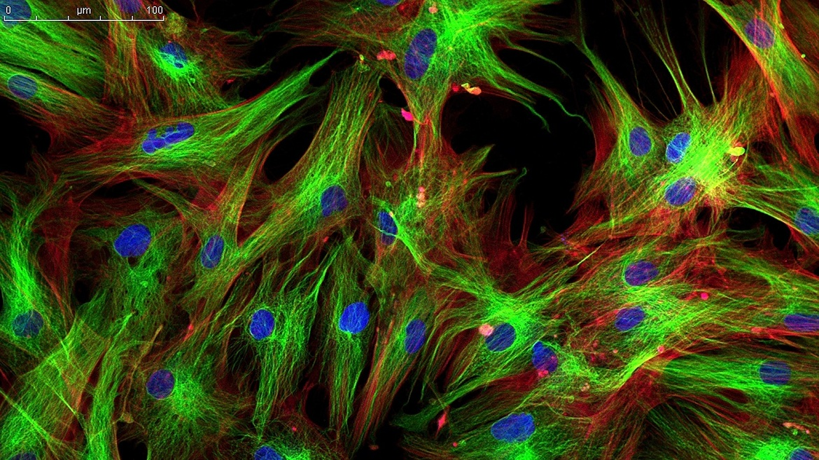
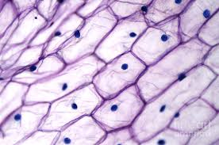
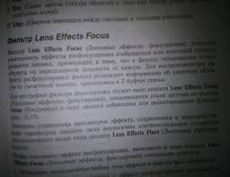
What kinds of images might we look at?

Slide 26
Image formats and compression
It is important to have your data in the right format for the analysis you would like to perform.
Some formats are considered lossy due to some compression when converting and saving in this format.
Others are lossless, and uncompressed. This is more important when you would like to extract quantitative data from your image. They also tend to have larger file sizes.
Many microscope manufacturers have their own proprietary image types and these will require specific tools to extract data from.

Slide 27
Some common data formats
JPG or JPEG – Typically lossy and small bit depth (values range from 0 to 255). Can be grayscale or RGB, most common on standard digital cameras.
PNG – Lossless image format but not high bit depth (0 to 255). Can also contain a transparency channel (alpha). One of the most common image formats.
TIFF or TIF – Most common format in scientific imaging. Generally lossless and can have a bit depth up to 16 bit (0 to 65,535) in both grayscale and color. TIFF files can also be image stacks.
CZI (zeiss) and LIF (Leica) – Proprietary image formats that can contain extra information about imaging and microscopy conditions.
HDF5 / N5 - Hierarchical Data Format, designed to store very large amounts of structured data.

Slide 28
Some common data formats
JPG or JPEG – Typically lossy and small bit depth (values range from 0 to 255). Can be grayscale or RGB, most common on standard digital cameras.
PNG – Lossless image format but not high bit depth (0 to 255). Can also contain a transparency channel (alpha). One of the most common image formats.
TIFF or TIF – Most common format in scientific image. Generally lossless and can have a bit depth up to 16 bit (0 to 65,535) in both grayscale and color. TIFF files can also be image stacks.
CZI (zeiss) and LIF (Leica) – Proprietary image formats that can contain extra information about imaging and microscopy conditions.
HDF5 / N5 - Hierarchical Data Format, designed to store very large amounts of structured data.

Slide 29





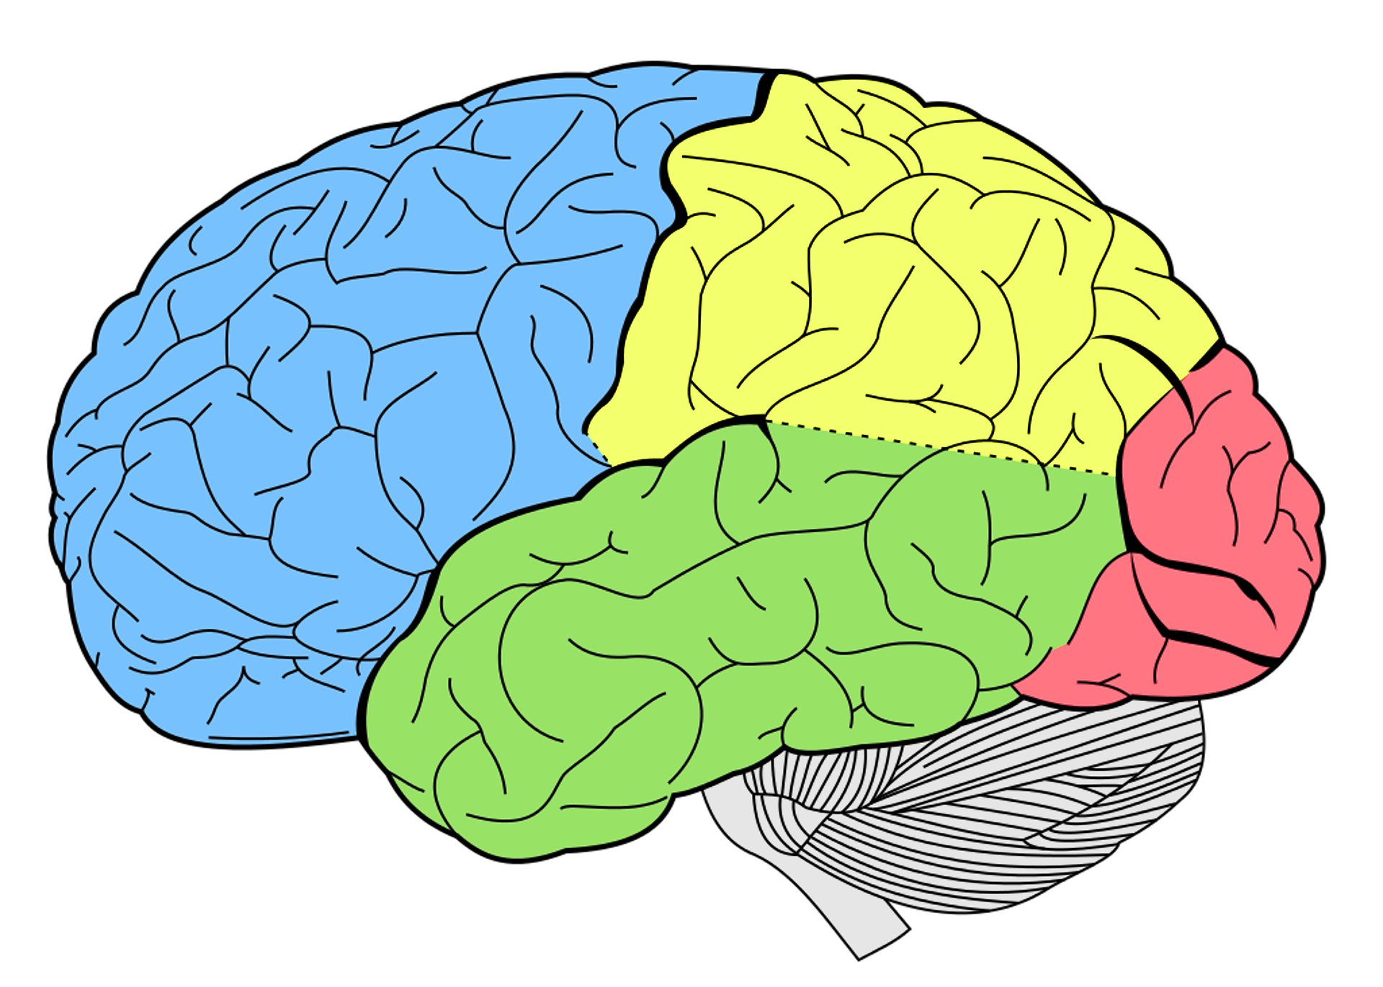


Tools used in this workshop

Slide 30
Libraries we will be using
One of python’s major advantages is it’s extensive libraries that have been developed for a variety of different applications.
We’ll be focusing this workshop on the libraries shown here.

Slide 31
Advanced matrix calculator and high-level math

Slide 32
Graphing, plotting, and viewing images

Slide 33
High-level image processing

Slide 34
Data management, manipulation and analysis

Slide 35
What we’ll be doing
The course has two tracks
Fully completed notebooks
Fill in the blanks notebooks
You’re strongly encouraged to work in pairs/groups, and to use google to look for answers. This is how this works in the real world!
If you have basic experience programing, you should be able to fill in the blanks.
If you don’t, you can either tag along with someone who’s more experienced, or just follow along with a completed notebook. We’ll be going over everything together, leaving time for you to try and figure stuff out on your own.

Slide 36
Working on your own data
Test data is included as part of the workshop.
Please only attempt to try your own data after you completed the task with the test data.
My ability to debug your code will be limited
If you need further help with your own data, the Collaboratory offers consultation/collaboration on image processing (among other things)

Slide 37
Breakout sessions
During the workshop, I will periodically transition you to breakout rooms where you can work together on completing the code.
You’re strongly encouraged to share screens and work together.

Slide 38
Setup
Let’s get going!
We need to download/clone the relevant course material and access it using jupyter notebook

Slide 39
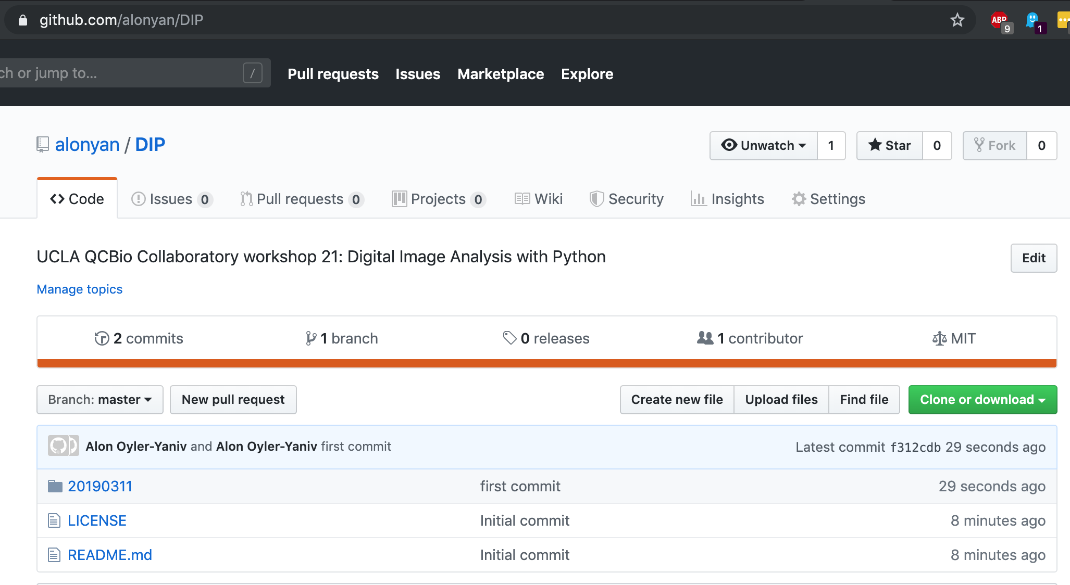
Cloning/Downloading the course repository
Go to https://github.com/alonyan/DIP
Download the repo

Slide 40
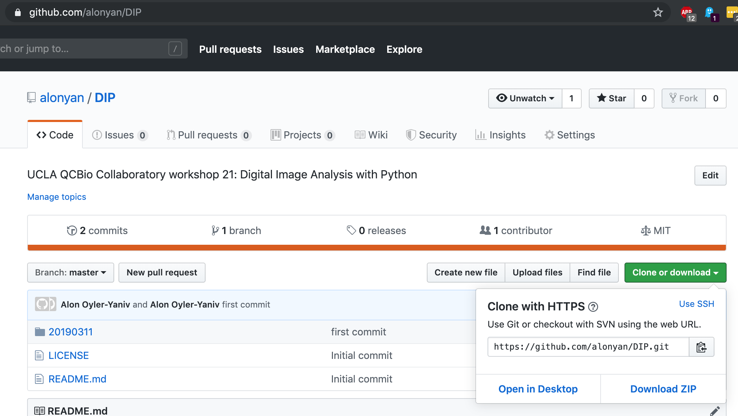
Cloning/Downloading the course repository
Go to https://github.com/alonyan/DIP
Download the repo

Slide 41
Cloning/Downloading the course repository
Move the .ZIP file to wherever you want it (/Documents is a good spot) and unzip
You can also navigate (cd) in the terminal/command line to wherever you want it and type:
git clone https://github.com/alonyan/DIP

Slide 42
Getting started with Jupyter Notebooks

Slide 43
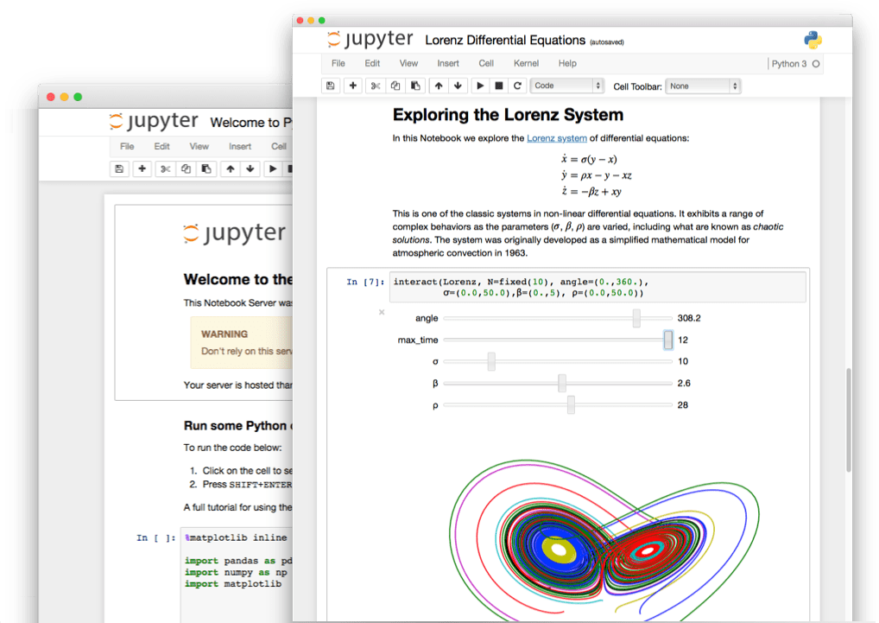
Jupyter notebooks
Jupyter notebooks are special documents that allow you to create and share documents live code.
They are a great way to keep your coding endeavors organized and share useful analysis with others.

Slide 44
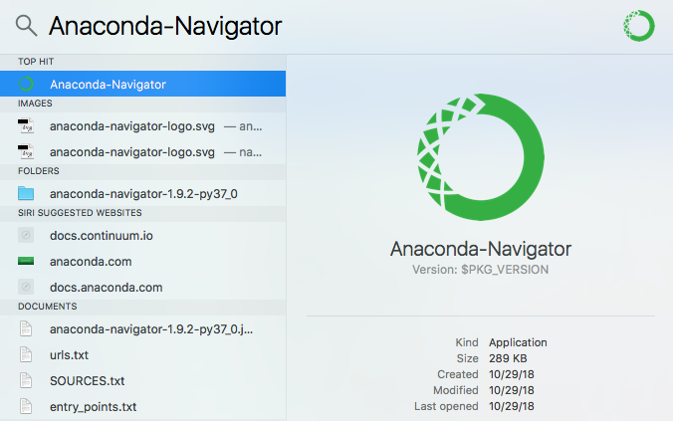
Getting started in Anaconda
Launch the Anaconda application.
MAC: Hit command+<space bar> and type “Anaconda”
WINDOWS: Look for Anaconda on your start menu
This should start you in the home directory.

Slide 45
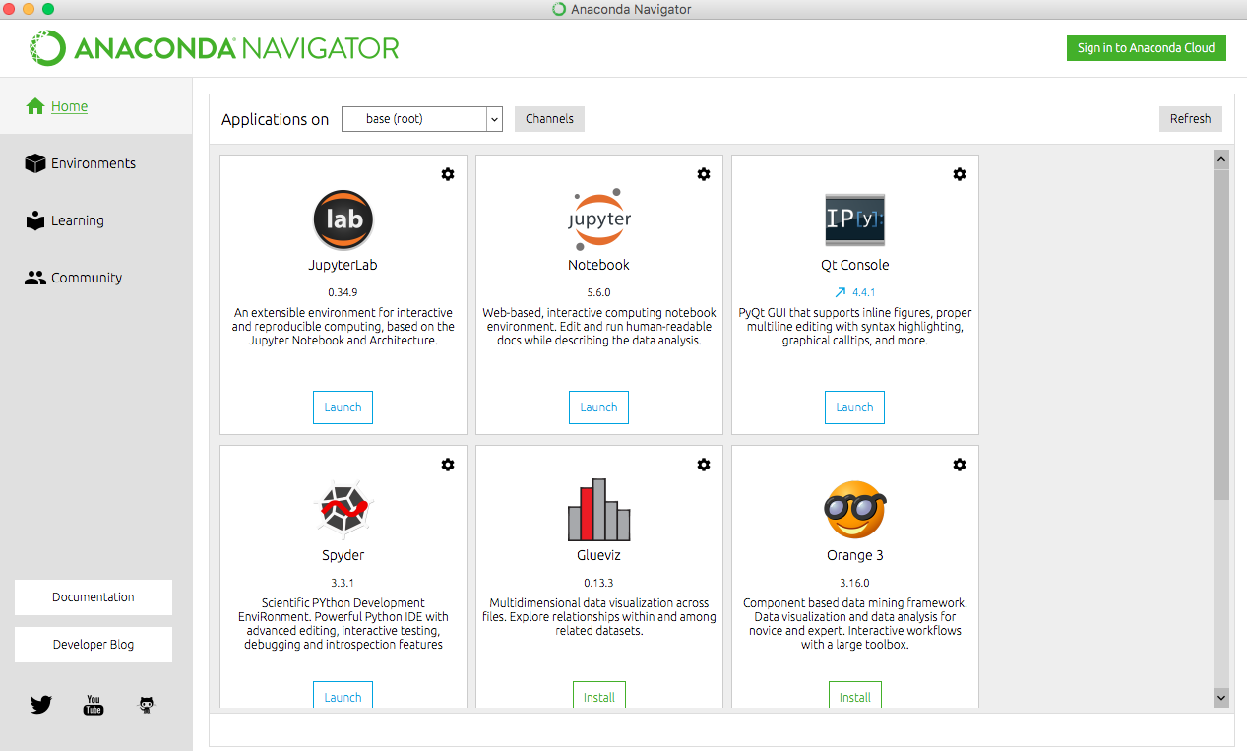
Getting started from Anaconda
Click on the launch button under the jupyter notebook icon. After a few moments the dashboard should open in your default web browser.

Slide 46
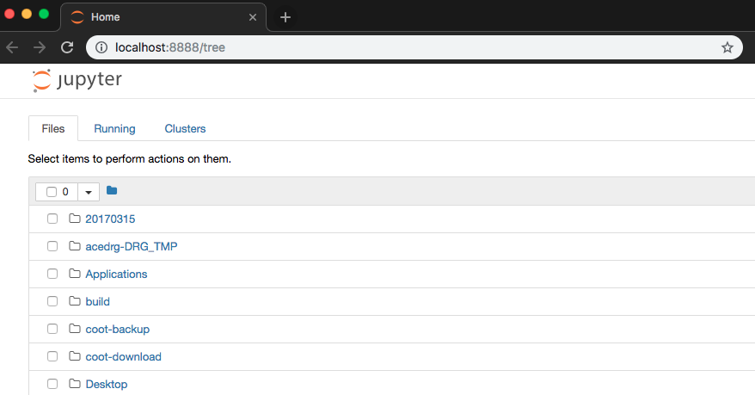
The jupyter dashboard

Slide 47
The jupyter dashboard
The file browser allows us to navigate to different locations on our computer and open specific files.

Slide 48
The jupyter dashboard
If you would like to launch in a new tab or change browser just type this url to get back there.

Slide 49
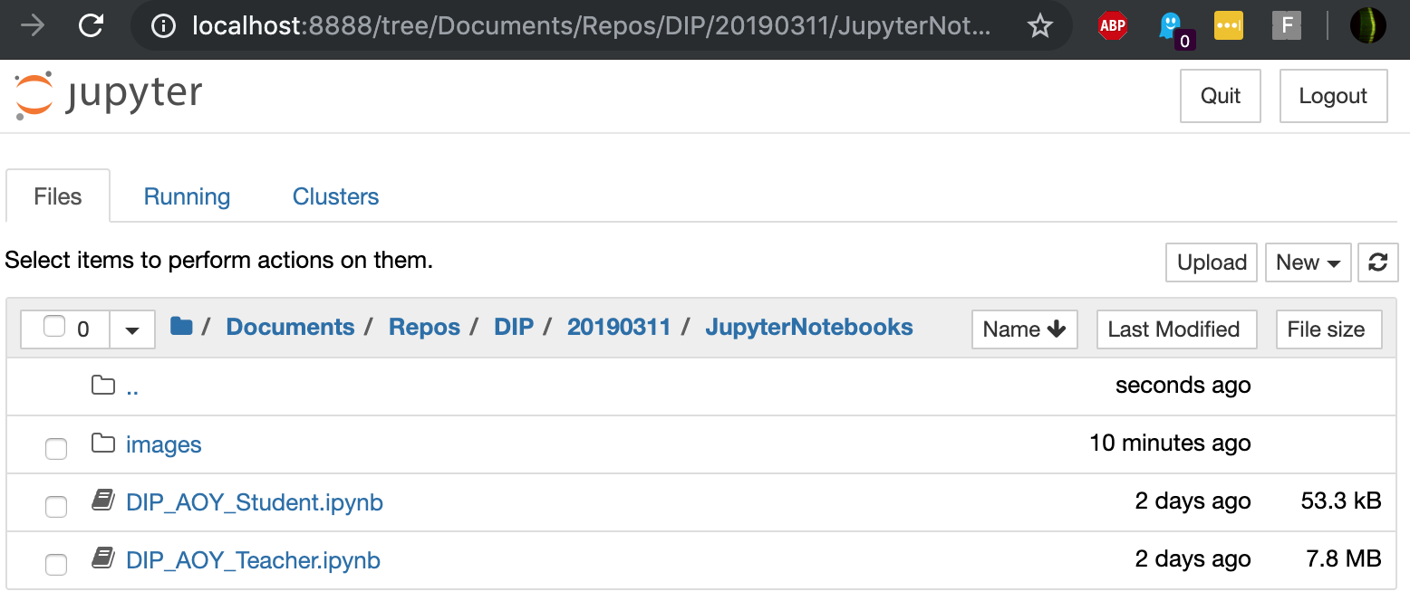
The jupyter dashboard
Navigate to wherever you saved the repository

Slide 50
The jupyter dashboard
*.ipynb is the suffix of a notebook. Open the Student version (preferably) or the Teacher version of the nb.

Slide 51
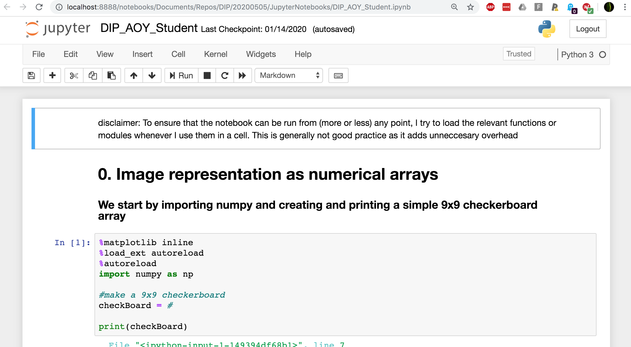
You should see something like this
Notebooks are divided into code blocks called “cells”. To run all the code in a specific cell hit Shift+Enter

Slide 52
Python package structure – Modular programming
Package . Module . Function
Collection of modules
Directory containing *.py files (and an __init__.py)
Collection of functions
Single *.py file
Does a thing
Text within a *.py file
Import package as pkg pkg.module.function()
From package import module module.function()
From package.module import function function()
From module import * any_function_in_module()

